Slide 1
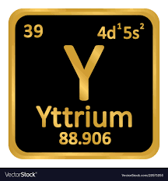
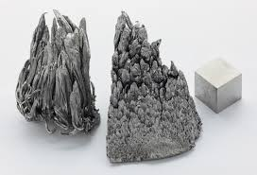
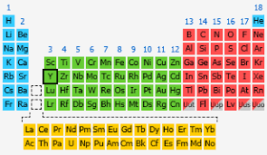
Yttrium
By
Student Name
Element: Yttrium
Element Symbol: Y
Appearance: Silver White
Mass Number:89
Atomic Weight: 88.905g/mol
Atomic Number: 39
Electrons:39
Protons:39
Neutrons 50
Period : 5
Group: 3
Block: d
Element category: Transition Metal

Slide 2
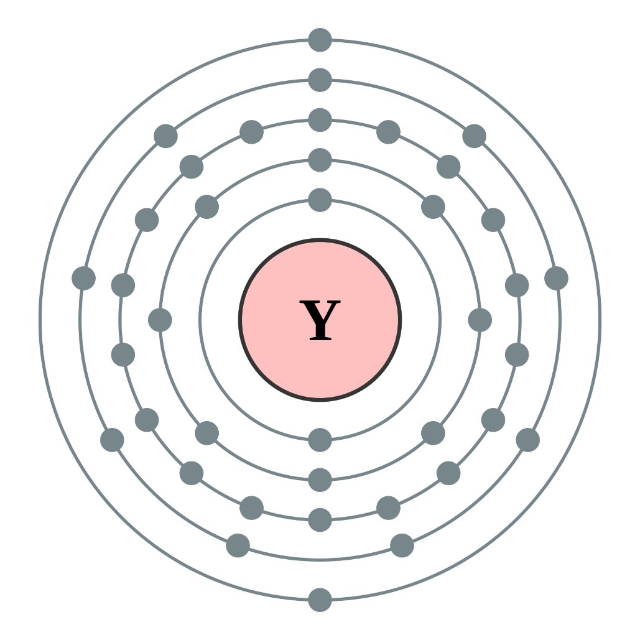
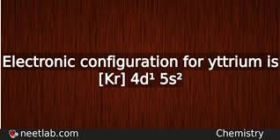
Yttrium Subatomic Particles
The number of protons, neutrons, and electrons in a common ion of my Yttrium are:
Mass Number:89
Atomic Weight: 88.905g/mol
Atomic Number: 39
Electrons:39
Protons:39
Neutrons 50

Slide 3
Relative Abundance Of Yttrium Isotopes
Isotope | Mass / Da | Half-life
⁸⁷Y | 86.910880 | 3.35 d
⁸⁸Y | 87.909506 | 106.6 d
⁹⁰Y | 89.907152 | 2.67 d
⁹¹Y | 90.907301 | 58.5 d
Average Atomic Mass = (Mass of Isotope 1 x Fractional
Abundance of Isotope 1) + (Mass of Isotope 2 x
Fractional Abundance of Isotope 2) + ......
Therefore, relative abundances (percentages) of different
Isotopes affect the weighted average (atomic mass)
(Su, et al., 2019).
Unabbreviated electronic configuration is:
1s2 2s2 2p6 3s2 3p6 3d10 4s2 4p6 4d1 5s2

Slide 4
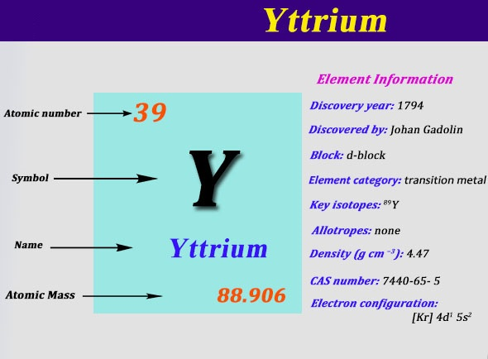
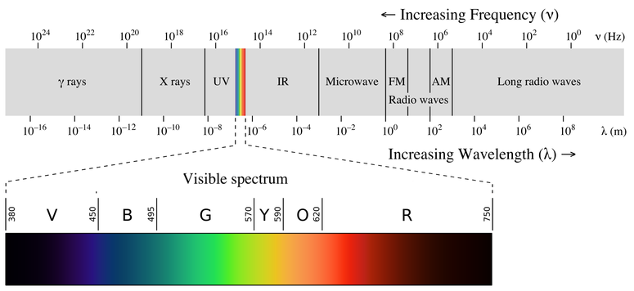
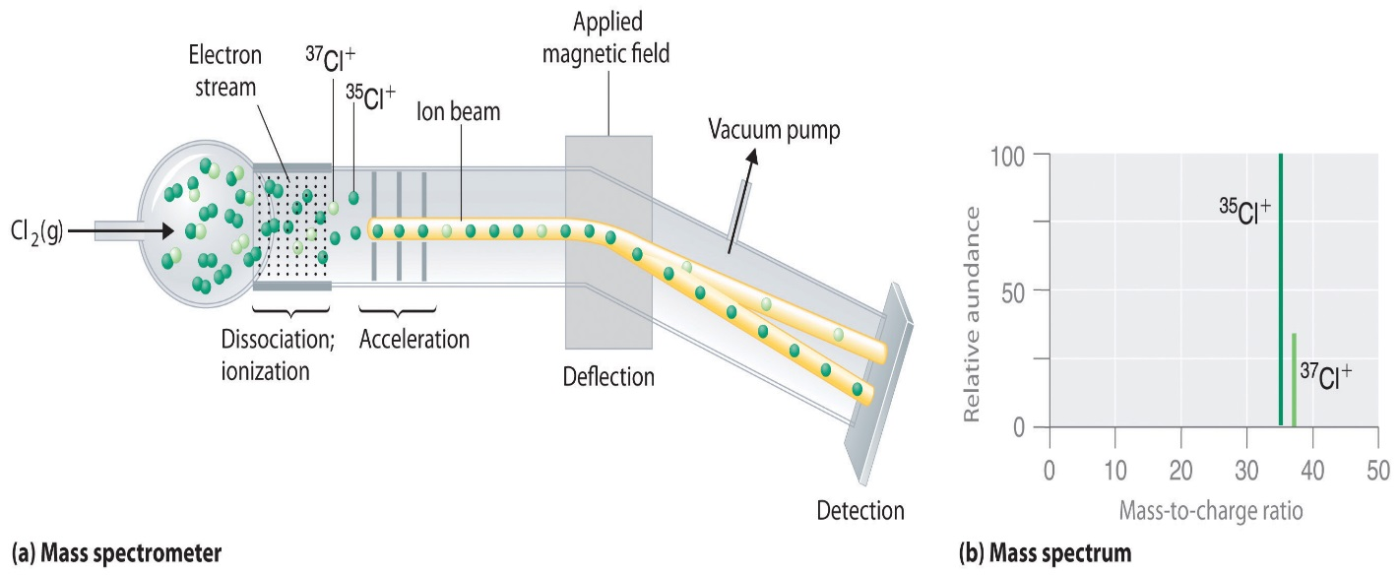
Patterns In Light Emission Spectra To Identify Yttrium
The electromagnetic spectrum is an example of a continuous spectrum
Yttrium emits green light in the spectrum.

Slide 5

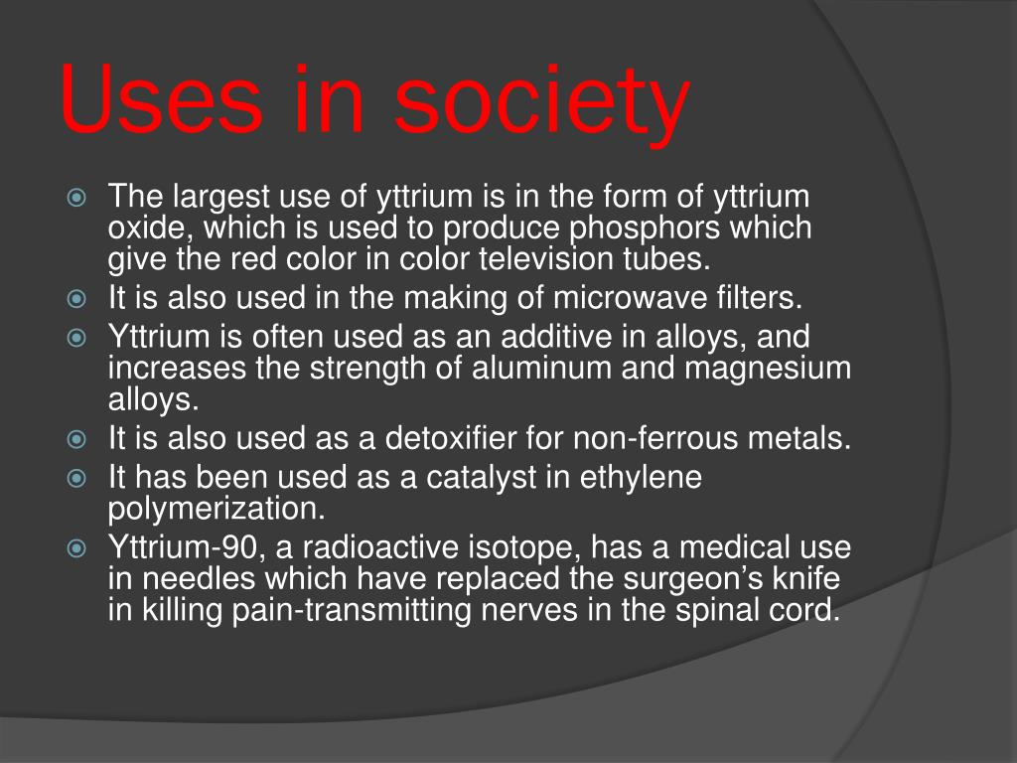
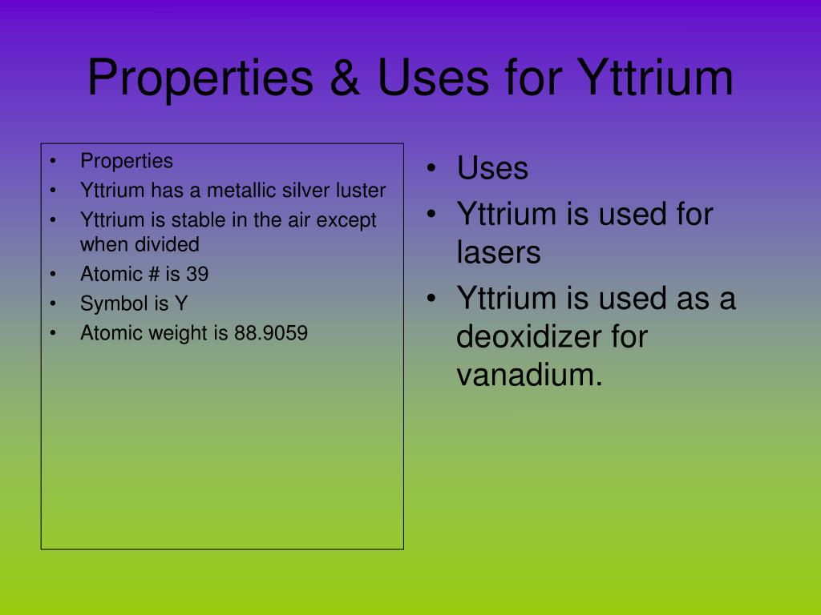
Valency, Periodic, Group, And Properties Of Yttrium
Yttrium is a Transition Metal of Period : 5, Group: 3, and Block: d (Liu et al., 2017)

Slide 6
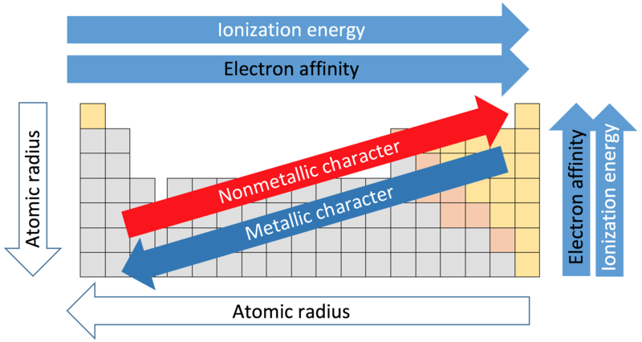
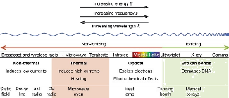
Atomic Radii (AR), Ionization Energy (IE) And Electronegativity (EN)*
The electron affinity of Yttrium is 29.6 kJ/moI,
Yttrium atomic radius is 212 pm, while it's covalent radius is 162 pm.
Element's number of shells and effective nuclear charge cause the AR, IE, and EN to be lower than other elements in the table as shown in the periodic table below
Notes:
I have met expectations AND have related how element's number of shells and effective nuclear charge cause the AR, IE, and EN to be higher or lower than other elements in the table (i.e., explained how it fits into the periodic trends).
I have used the periodic table as a model to identify patterns in AR, IE, and EN. The description included the AR, IE, and EN* values for my element, described what these terms mean, AND explained how the number of shells and the effective nuclear charge (proton pull) affect these values.

Slide 7
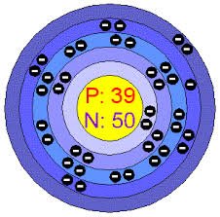
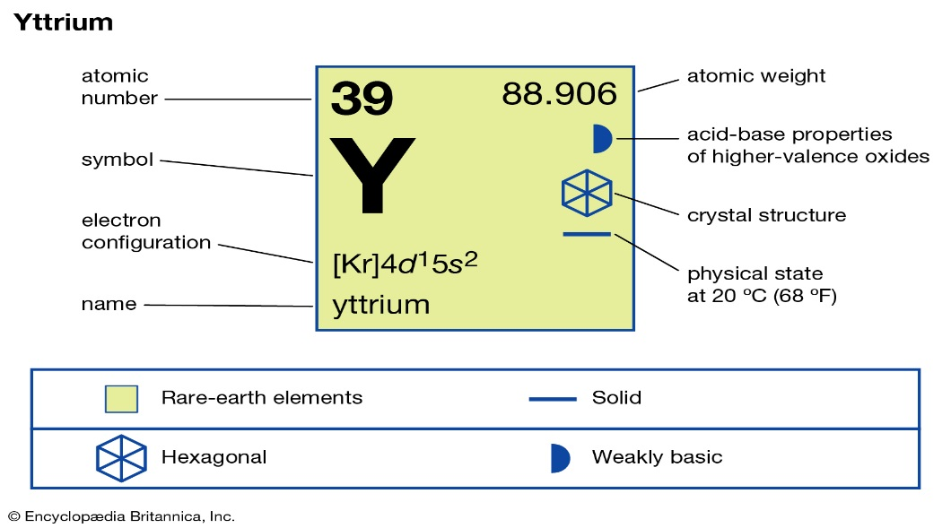
Chemical Properties of Yttrium
Yttrium is fairly stable in air, because it is protected by the formation by the formation of a stable oxide film on its surface, but oxidizes readily when heated.
oxide yttria, Y₂O₃ is the largest element which is used in making red phosphors for color television picture tubes (Zou et al., 2005)
Yttrium is very reactive towards the halogens fluorine, F₂, chlorine, Cl₂ bromine, Br₂, and iodine, I₂.
Solid yttrium metal does not react with oxygen in the air.

Slide 8
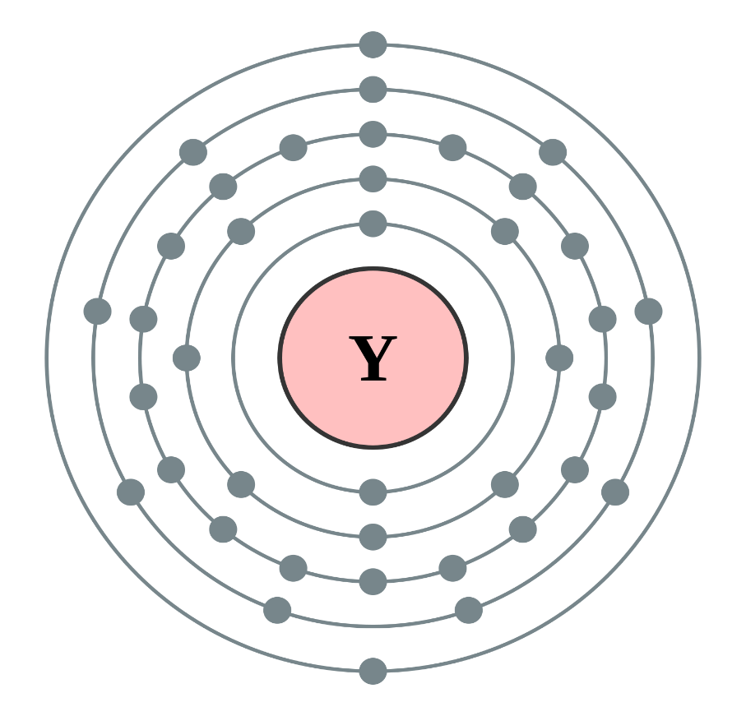
Models of Electron Configuration to Determine Chemical Properties Of Yttrium
Elements are organized by period and group,
The period corresponding to the principle energy level
The group relating to the extent the subshells are filled.
The properties of an atom relate directly to the number of electrons in various orbitals,
The periodic table is much like a road map among those orbitals such that chemical properties can be deduced by the position of an element on the table (Zou et al., 2005).
The electrons in the outermost or valence shell are especially important because they can engage in the sharing and exchange that is responsible for chemical reactions (Liu et al., 2017).
Yttrium has Protons:39, and Neutrons 50 from Period : 5, Group: 3, and Block: d.

Slide 9
References
Liu, X., Shan, D., Song, Y., & Han, E. H. (2017). Influence of yttrium element on the corrosion behaviors of Mg–Y binary magnesium alloy. Journal of Magnesium and alloys, 5(1), 26-34..
Liu, L., Yuan, F., Zhao, M., Gao, C., Feng, P., Yang, Y., ... & Shuai, C. (2017). Rare earth element yttrium modified Mg-Al-Zn alloy: Microstructure, degradation properties and hardness. Materials, 10(5), 477.
Su, J., Guo, F., Cai, H., & Liu, L. (2019). Study on alloying element distribution and compound structure of AZ61 magnesium alloy with yttrium. Journal of Physics and Chemistry of Solids, 131, 125-130.
Zou, H., Zeng, X., Zhai, C., & Ding, W. (2005). The effects of yttrium element on microstructure and mechanical properties of Mg–5 wt.% Zn–2 wt.% Al alloy. Materials Science and Engineering: A, 402(1-2), 142-148.

Slide 10
My contact information
If you need an more help with your assignments.
Contact directly me through
Whatsapp +254711987226.
Email address: geomuhia1@gmail.com
These makes the communication fast and easier.
Thank you for offering me an opportunity to serve you.
I wish you all the best in your studies.
Looking forward to hearing from you.
DELETE THESE SLIDE FROM YOUR SUBMISSION DOCUMENT

